Slide 1
Composing music electronically
a guide for non-musicians

Slide 2
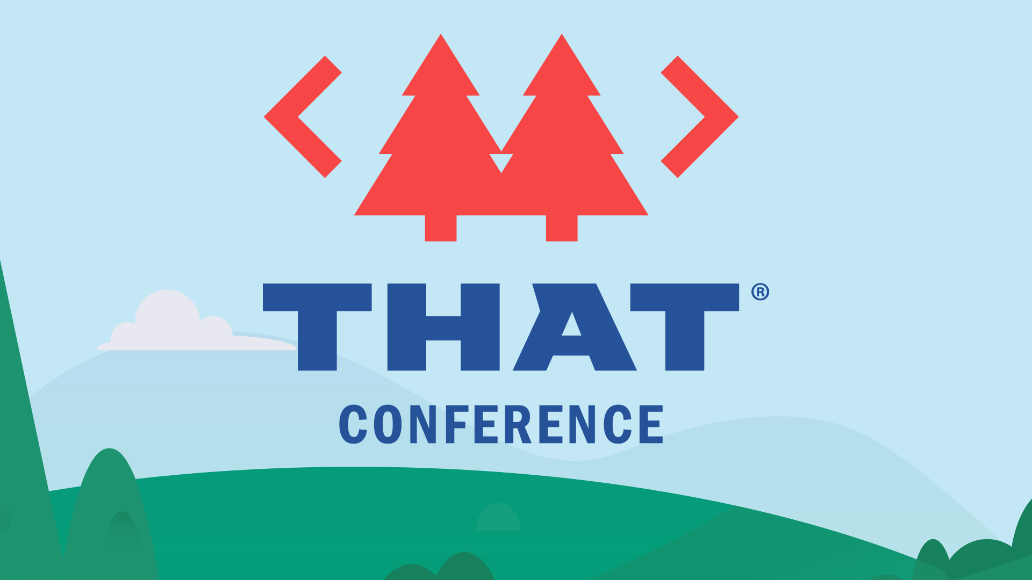

Slide 3
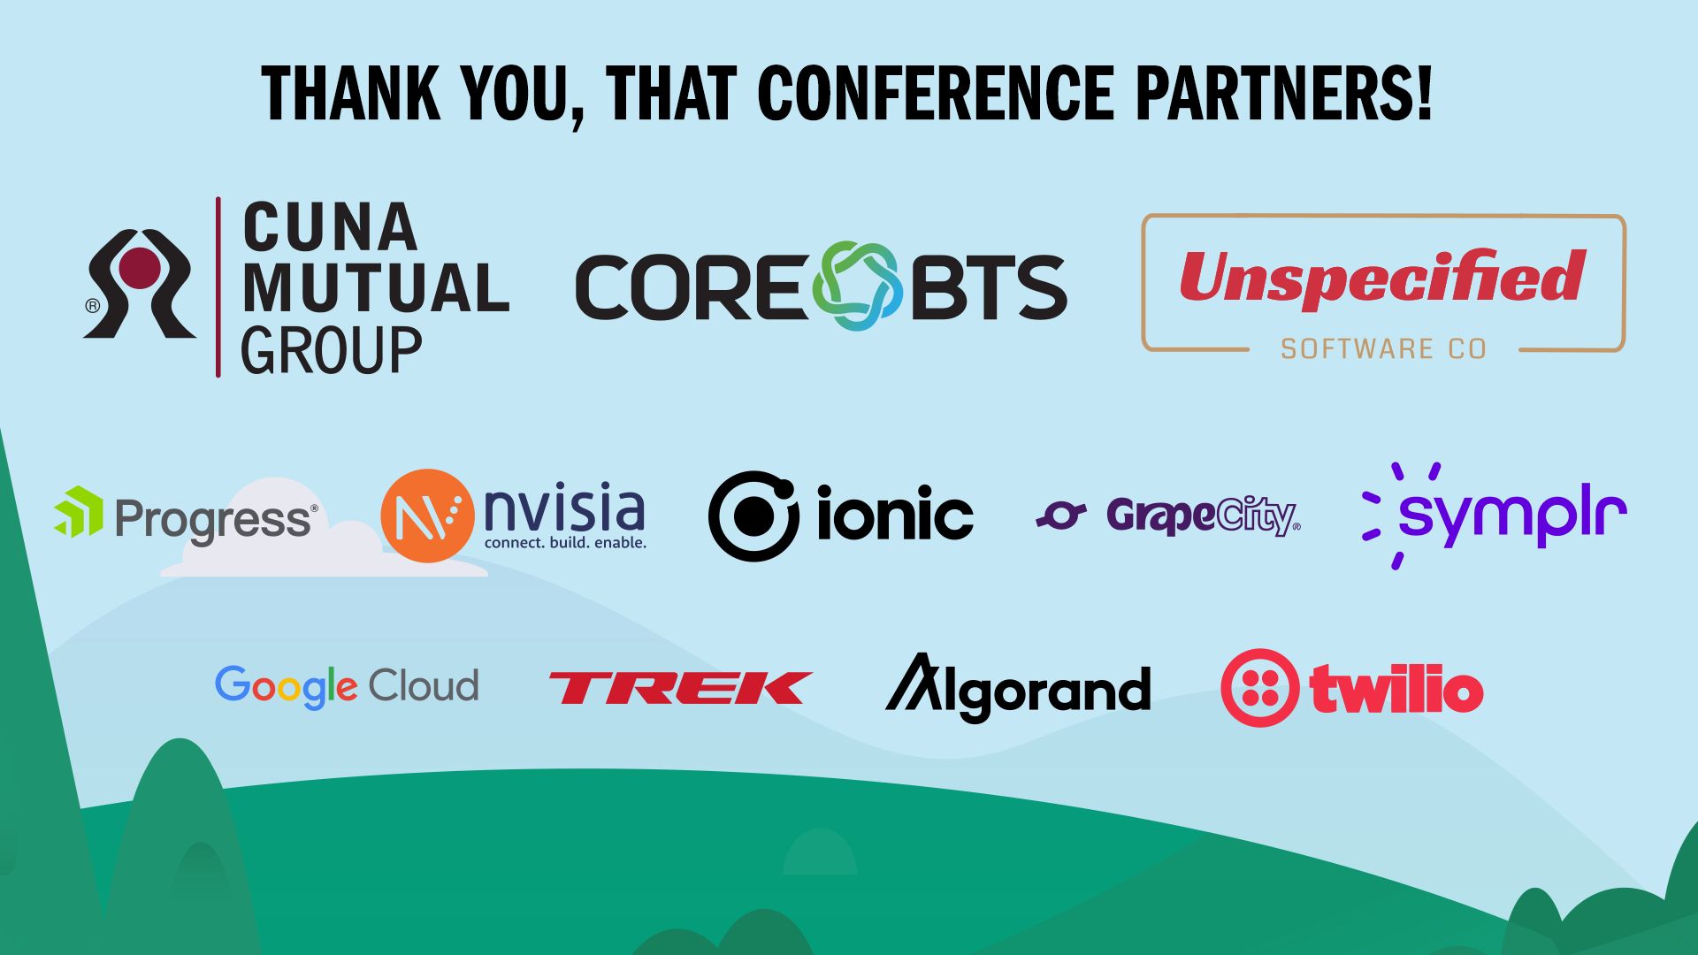

Slide 4
About me
Josh Forde
josh@joshforde.com
linkedin.com/joshforde
Senior software engineer by day
Game developer by night

Slide 5
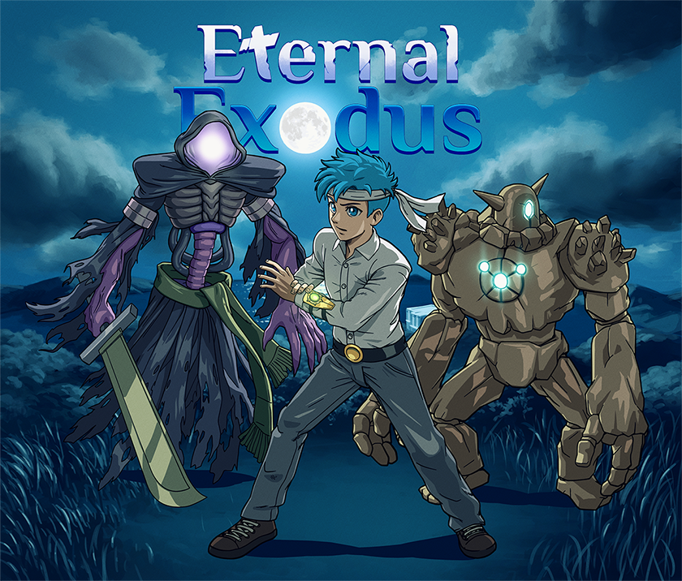
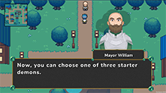
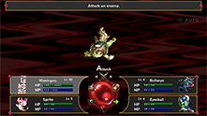
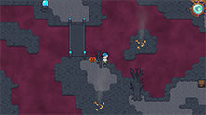
About me
Self-taught in music, around 60-70 completed songs across 3 games
Current project: Eternal Exodus, a monstercatching
RPG on PC/PS4/Switch/XB with a fully original soundtrack

Slide 6
Inspiration behind this talk
Making music is fun
But there’s so much to learn
Music theory itself is a massive topic
Sometimes, it feels like you have to learn everything before you can even begin your first song
Even introductory lessons online often assume you’ve at least played an instrument
What if you’re starting from zero?
How quickly can you learn enough to write a song?

Slide 7
Goals of this talk
Learn a step-by-step approach to writing a song that sounds “decent” quickly
“Decent”: it sounds like a song, not like noise
All instruments in sync with each other rhythmically
No “dissonance” (notes clashing with each other)
Learn basic guidelines for keeping your song from devolving into chaotic noise
With the foundation in place, you’ll be able to start experimenting with melodies and making songs that sound great
Making music that “moves” takes a lot of trial-and-error – more time than this talk allows – BUT anyone can do it once the foundation is in place
After this talk, you’ll have the tools and guidelines to start experimenting with making

Slide 8
The workflow I usually use
Songwriting part:
1. Compose in a web app called HookPad
(this is what the talk will mostly focus on)
Production part:
1. Export HookPad composition to MIDI file (*.mid)
2. Import MIDI into DAW (FL Studio, Reaper, GarageBand, etc.)
3. In your DAW, attach instruments and effects to those MIDI notes
4. Export final song to wav/mp3/etc.

Slide 9
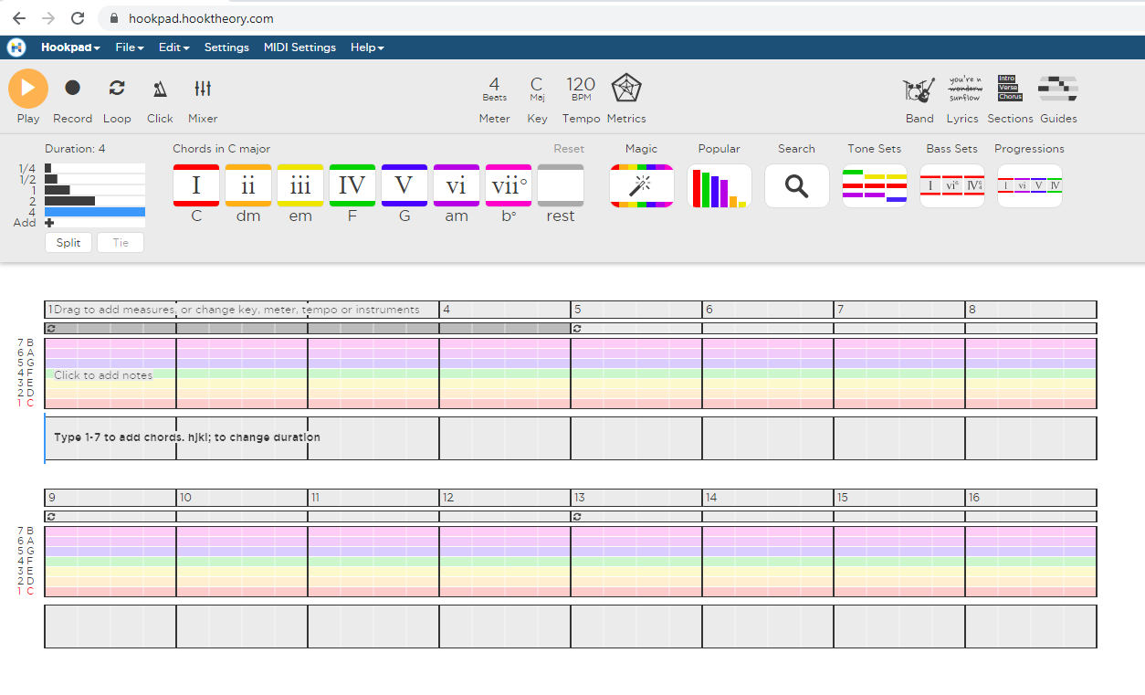
HookPad

Slide 10
Scales
Often the first thing you’ll choose before writing a song
Choosing a scale:
Major scale (default)
“happy,” upbeat music
Minor scale
“sad” music
Others exist, but these encompass 90+% of what you hear on the radio
Disclaimer: these are guidelines and massive oversimplifications!
Plenty of “happy” songs exist in minor, and “sad” songs in major
In HookPad, you can try changing a song from “major” to “minor” after you’ve written it to hear the subtle difference

Slide 11
Instruments in a HookPad song
1. Drums
HookPad does this for you automatically, but can be adjusted a bit
Major changes to the drum beat will require using a DAW (more on that later)
2. Bass (bass guitar or other low-frequency instrument)
Subtle, but helps emphasize the rhythm of the song
HookPad does this for you as well – need a DAW to override it
3. An instrument that plays the harmony (chords)
The “background” music (not the melody)
Helps guide the song through its journeys of “ups” and “downs”
4. An instrument that plays the melody
The fun part!

Slide 12
Chord progressions
A “chord” is just “3 or more notes playing at the same time”
In most songs, an instrument will play a bunch of chords throughout the song, instead of playing a melody
A series of chords is called a “chord progression”
One instrument plays these “in the background” while a different instrument plays melodies on top
To greatly oversimplify: the purpose of the chord progression is to make the melody sound better

Slide 13
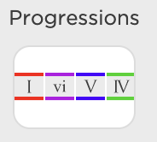
Chord progressions
HookPad has a feature for choosing popular chord progressions

Slide 14
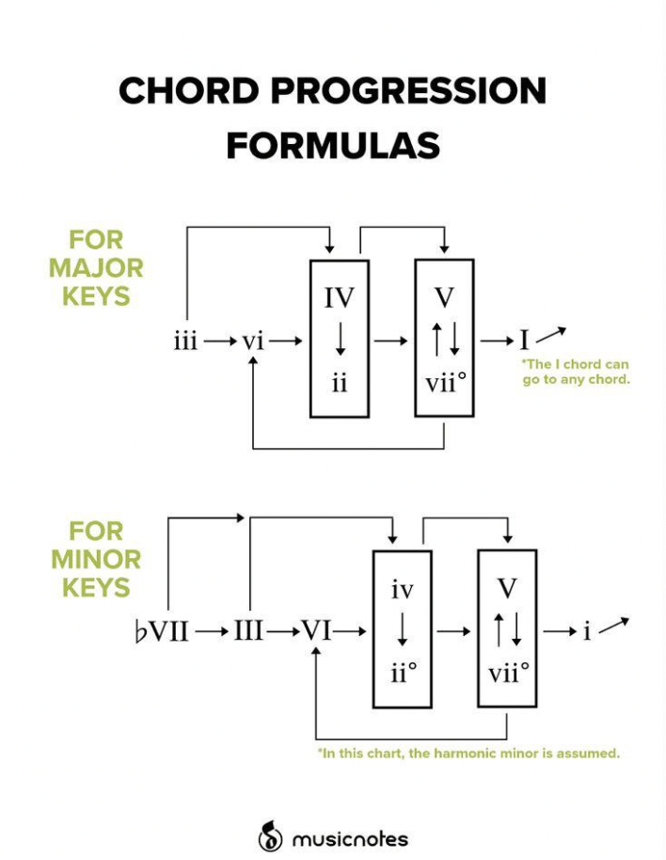
Chord progressions
Don’t worry about this for now, but…
As you get more advanced, you can experiment with creating your own chord progressions
This chart gives you a guideline of which orders of chords will sound best
HookPad has a similar feature built-in, let’s take a look...

Slide 15
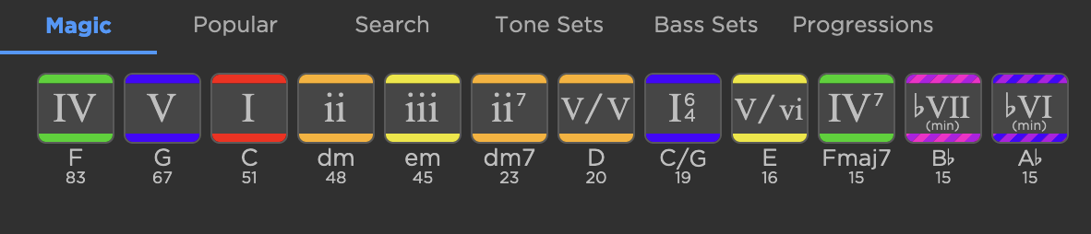
Chord progressions
If you click the Progressions button, and then the Magic tab, you’ll see this:
From left-to-right, HookPad shows you which chords other songs most frequently use “next” (after whichever chord you just wrote in your song)
In other words, in this example, the “IV” chord will probably sound really good next in the current song. Although we may also risk sounding predictable, since it’d be a common choice in the current circumstance: remember, this list is showing us what’s popularly been done in other songs.

Slide 16
Writing melodies
Tip before we start:
The “Guides” button in HookPad gives you a hint about which notes will sound “good” at any given time
These notes are called “chord tones,” because these notes match whatever notes are in the chord that the other instrument is playing at the same time

Slide 17
Writing melodies
Everyone writes melodies a little differently
Below are guidelines, and some tricks I sometimes do - not rules!
Some repetition is good
This is often what makes things catchy
Too much repetition is where things start to sound annoying
A really easy trick is to repeat a series of notes, but change one or two of them
Something of a “call and response”: the first phrase asks a question, and the second phrase “answers” it
So, have some number of bars (2 or 4 would be a good starting place), write a melody, copy and paste it immediately afterward, and change a note or two
Not sure which to change? Try changing the very last note of the first section to a higher note than it is in the second section.
Frequently, a song will start and end on the “root” note (the “1” in HookPad)
The “root” note is where the song feels “at home”
Moving away from the root note, and then coming back down to it, is like going on a little emotional journey

Slide 18
Resources for more in-depth learning
These resources will help you learn to write melodies & chord progressions:
HookPad’s “HookTheory Library”
Search for almost any popular song you can imagine to see its chords & melodies
You can open it and tweak it
Try erasing the melody, and writing a new one on top of a chord progression that you like
YouTube:
8-Bit Music Theory
Goes in-depth on music theory for popular video game songs
Can sometimes be difficult to understand without a background in music due to all the lingo
ShadyCicada
Also video game-related music composition videos
Showcases his writing process, composing songs in styles of popular games/genres
More entertaining, not strictly educational
Less technical / easier to understand

Slide 19
Now, let’s talk about production...
This is optional...
You can complete and export a song entirely in HookPad if you like
…But here’s where we get greater control over the “sound” of the song, using tools HookPad doesn’t have
We’ll export our HookPad song as a .mid file, and import it into another program called a “DAW”
The “song” (notes) will stay the same, but it will sound different
It’s like swapping in a new band/singer to play it

Slide 20
Digital Audio Workstation (DAW) software
DAWs are programs for music production
They replicate old music hardware used for recording, mixing, and editing music
Today, professional music producers usually use DAWs instead of physical workstations
Examples: FL Studio (paid), GarageBand (free on Mac), Ableton (paid), Reaper (free)
For our purposes, DAWs are pretty much for changing/improving the sound of your instruments
This is optional! HookPad allows you to export a full song as an audio file.
You can export from HookPad to a DAW by using the “Export to MIDI” feature in HookPad with the “Import MIDI” feature in a DAW.
You have finer-grain control over the sound in a DAW.
Replace the instruments with new ones, including more realistic-sounding ones.
Add “effects” to the instruments, giving subtle (or not-so-subtle) changes to how they sound
Miscellaneous other tweaks. Example: fade an instrument’s volume “in” during an exciting build-up.

Slide 21
VSTs
VSTs: software plugins for your DAW that emulate real-world music hardware
Two kinds of VSTs:
Instruments (sometimes called “VSTi”)
Guitars, flutes, pianos, violins
Synths: create your own sound (almost your own “instrument”)
Effects
These modify the sound of the insturment
Guitar amps/pedals, reverb, delay, compression, equalizers, etc.

Slide 22
Some great VSTs
On the next slides are some of my personal favorite VSTs
Most good VSTs cost money, unfortunately, but free options exist
Search online for “free VST instruments”
The vast majority of paid VSTs go on sale frequently, so be sure to search online to see when the last sale was before paying retail

Slide 23
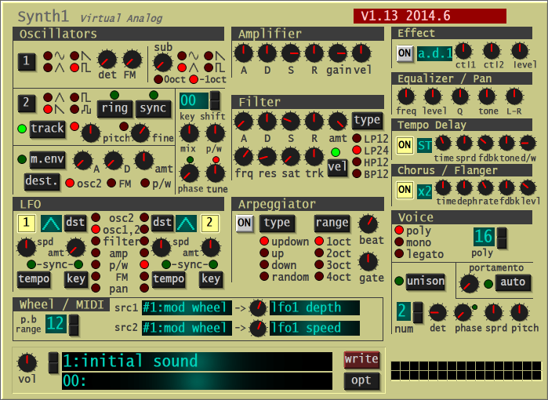
Synth1
Free synthesizer
Very flexible (can create many different types of sounds)
Loads of free preset packs available online
Many presets sound reasonably close to real instruments
The interface can be overwhelming, but...
Look up “Syntorial” to learn how to program synths
Or just use presets

Slide 24
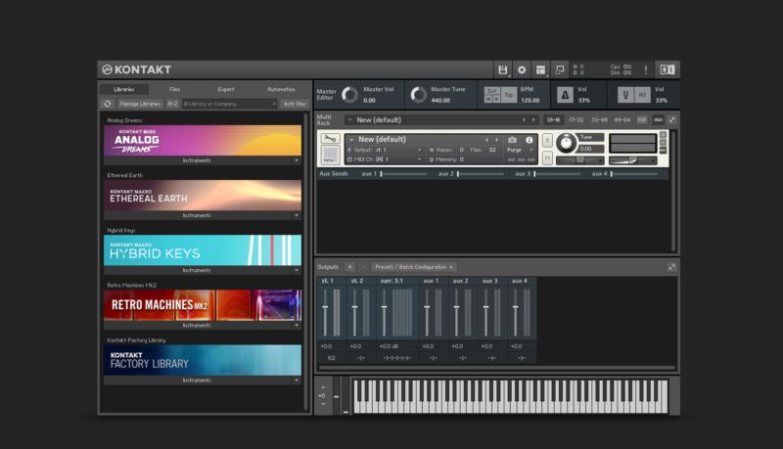
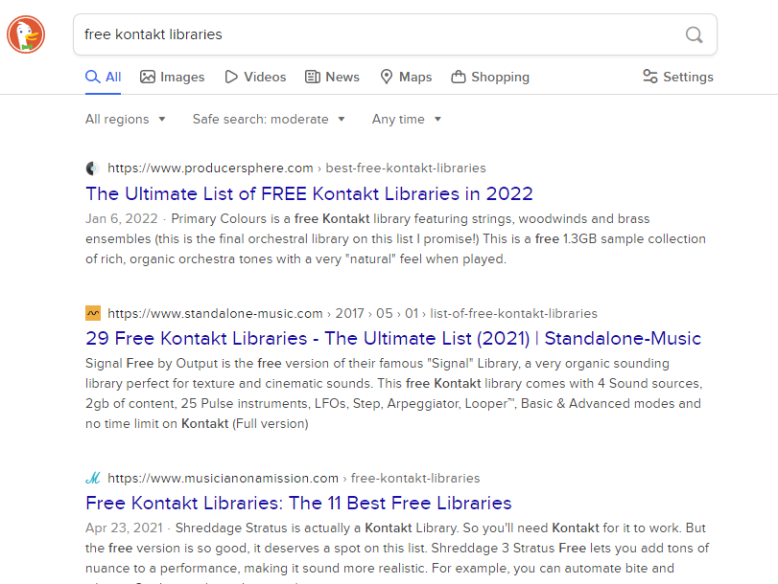
Kontakt 6 Komplete
Big collection of virtual instruments and sampled libraries
Includes the Kontakt Player, allowing you to download tons more sampled instruments, many of them free, that others have made
$400 :(
$400, but maybe you’re set on instruments for life afterward?
Really nice interface

Slide 25
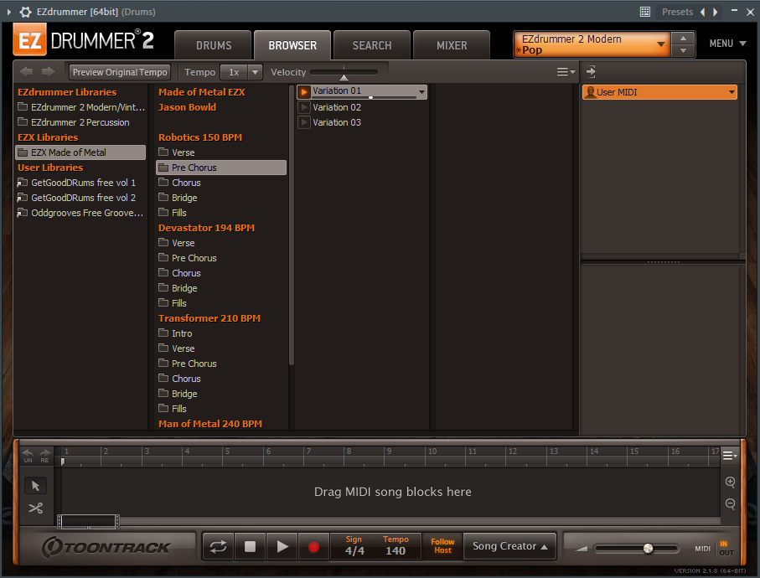
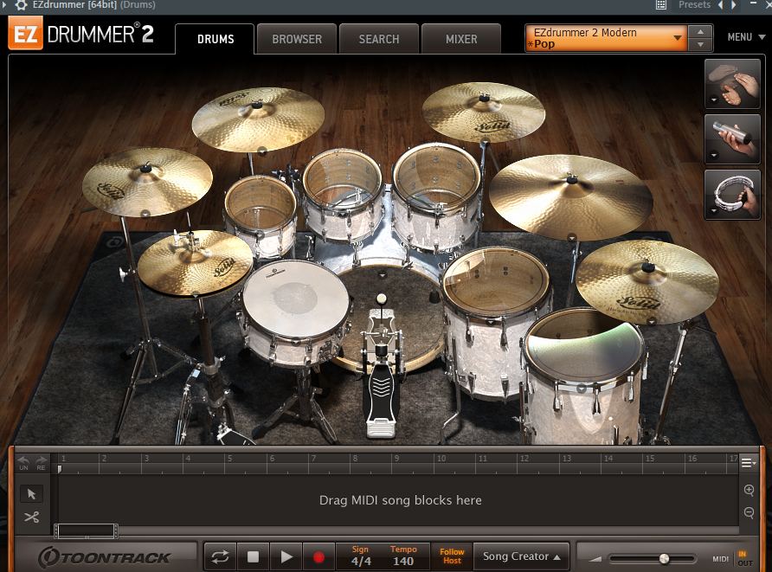
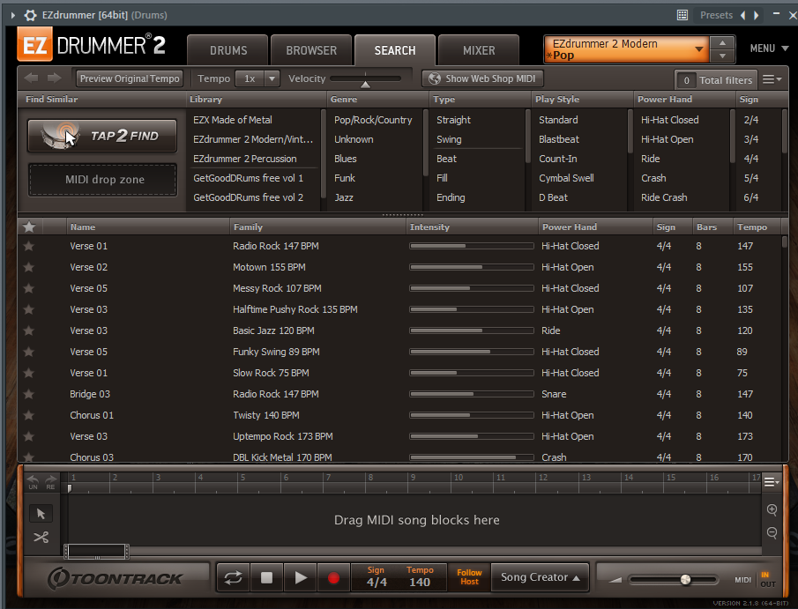
EZDrummer
$179
Variety of different drum samples to choose from
Get the sound that matches your needs
Many premade, searchable drum beats

Slide 26
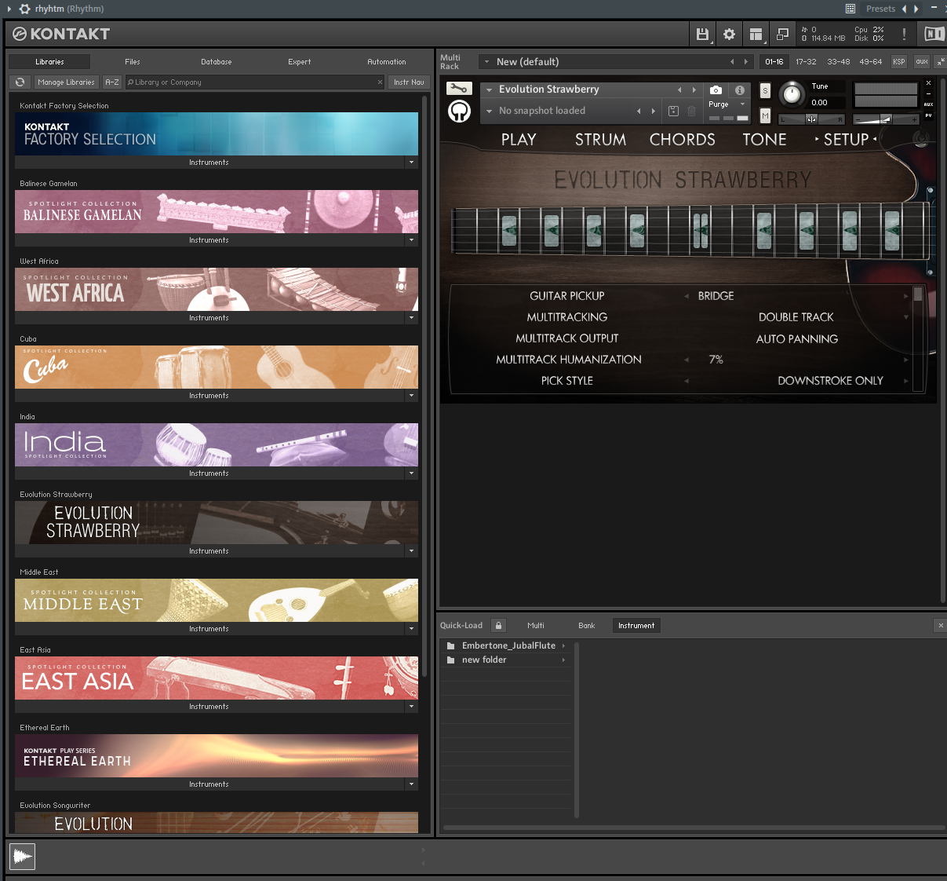
Orange Tree Samples guitar libraries
Variety of guitar sample libraries: electric guitar, acoustic, bass, banjo, etc.
Built on top of Kontakt, but most do not require you to own Kontakt
Around $180 each, regularly going on sale around $100

Slide 27
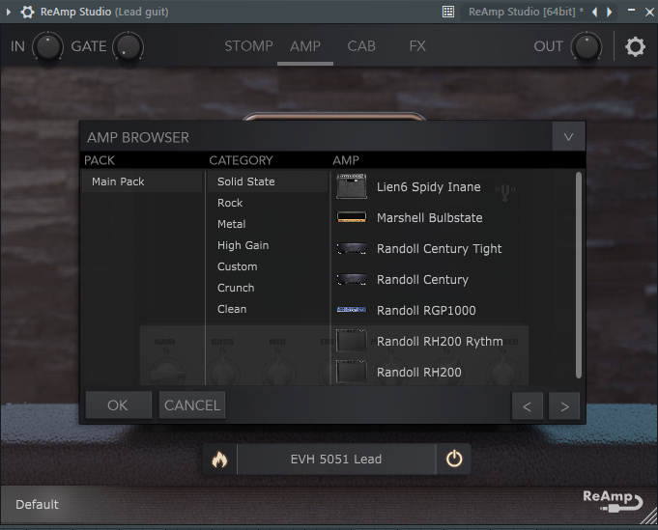
ReAmp Studio
Guitar amp simulator that sounds really close to a real amp (IMO)
Very customizable, with many presets that will give your guitar any number of sounds
$120, but on sale for $22 at this time of writing
Wait for a sale if it’s back to normal when you see this!

Slide 28
Thank you for coming
Slides available at https://github.com/Josh1billion/music/
Questions

